Slide 1
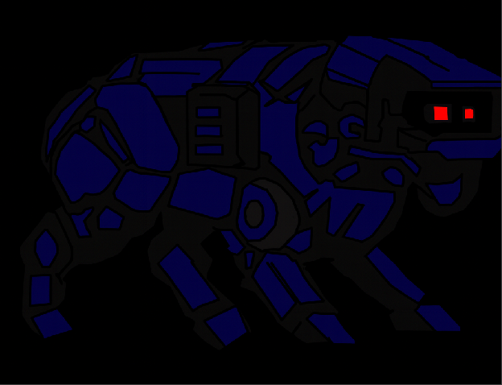
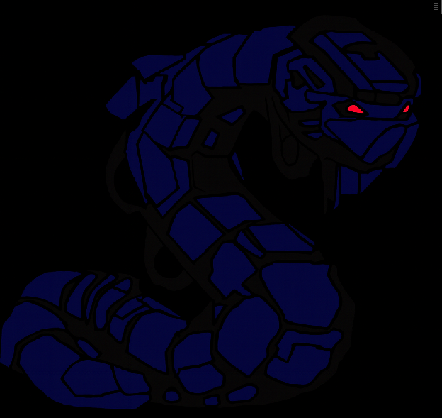

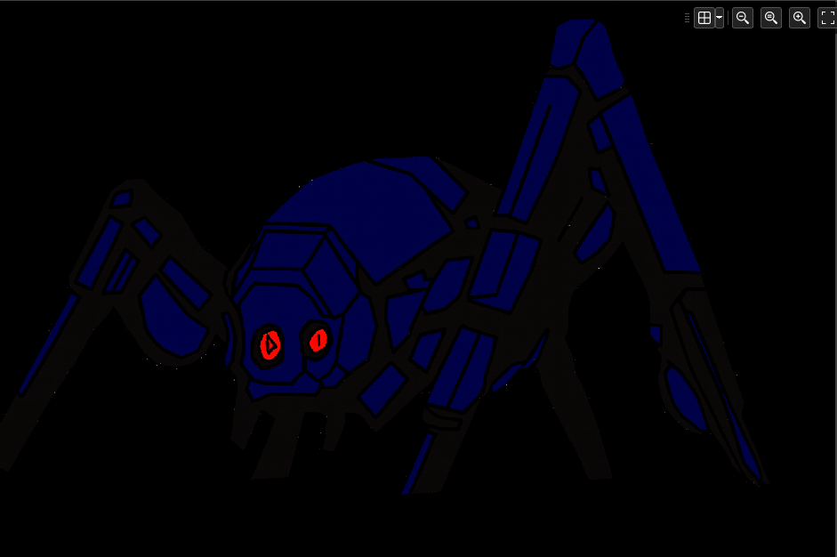
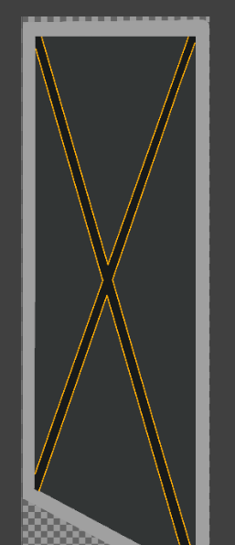
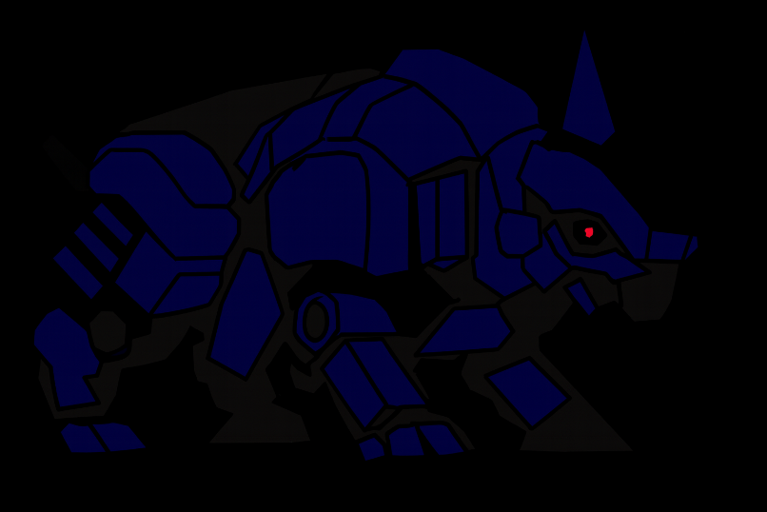
Game Build V.0.1
Date – 21/11/2025
What to do for Next Session
Study more about the specific GML code needed for enemy AI/Camera system
Enemy behaviour is unique between different enemies, as such they will have unique code.
Map Out zone's layout inside the main room.
Design Menu/Start-Up Screens.
Create the rest of the sprites ready for when their designs are ready.
Make the zones sprite canvas 1000x500 and give them a bold colour to start so you can begin mapping out the layout.
Also, attempt to make the main room as large as possible as to have more flexibility when designing the levels/layouts/zones.
Summary Of Session
I have finished outlining the design for the main office room.
I have corrected my enemies AMCD-01 to 04 to remove weird white spots left by the fill tool and now they are ready to be used in the game.
I have created the design/animation stages for the doors.
I have designed the buttons.
Lastly, I have begun adding the designs into Gamemaker and going over them, refining them to look cleaner.
Note: I made the backgrounds black to show them in a much darker environment, I do have PNG images of them with transparent backgrounds as to make them easier to use In Game Maker.

Slide 2
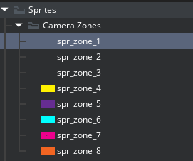
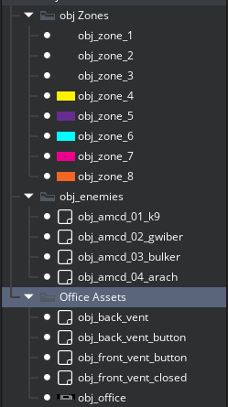
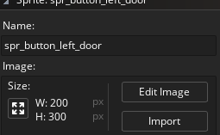
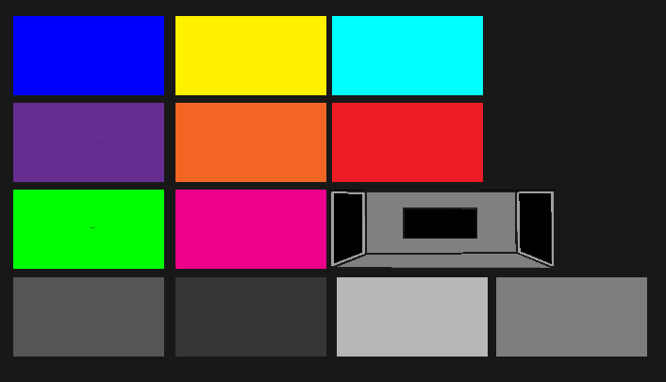
Game Build V.0.1
Date – 24/11/2025
What to do for Next Session
Allocate each zone to a location and name them specific to what contents are in it. For Example, 2 zones will be named obj_left_corridor and obj_left_corridor.
Summary Of Session
Colour coded each zone and named them correctly. These are to be used temporarily before the official designs are completed. The grey coloured zones are for the front views of both the vents and the doors.
I have also Created a template for the Office.
The Office will have a set size of 3000x1050, and the zones will have a set size of 2000x1050.
The Buttons for both the vents and doors are made in Game Maker and will be 200x300px to have more flexibility in designing.
The Camera button will start off being 300x100.

Slide 3
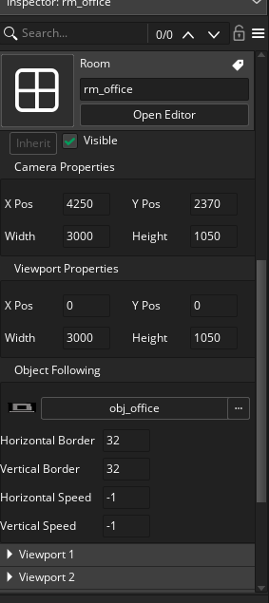
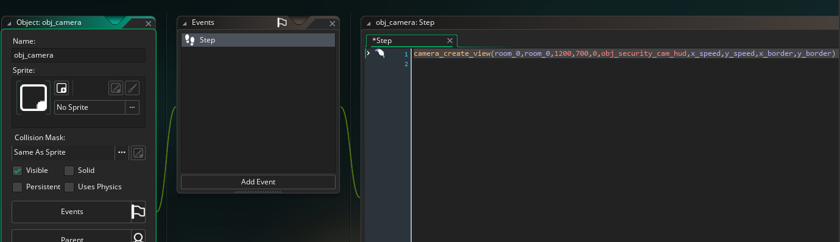
Continuation of previous slide.
Game Build V.0.1
Date – 24/11/2025
What to do for Next Session
Continue working on sprites and setting the game up ready for all the coding, so adding in all the assets/files.
Summary Of Session
I used View port feature on game maker to have the main camera be focused on the office.
The code below is the camera, that when I put in camera_apply or shift view onto a button Object it will change OBJ_Camera’s position within the room. It is not done yet but is a massive leap in completing one of my most advanced mechanics.

Slide 4
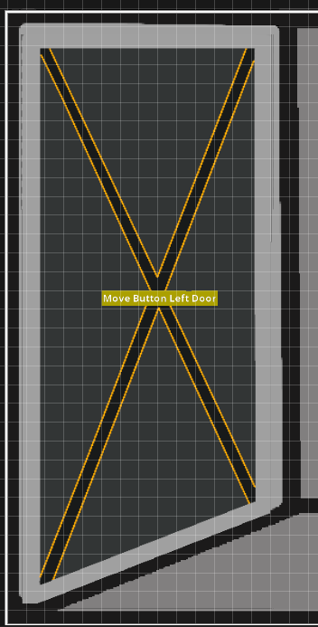
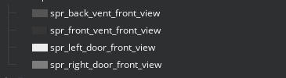
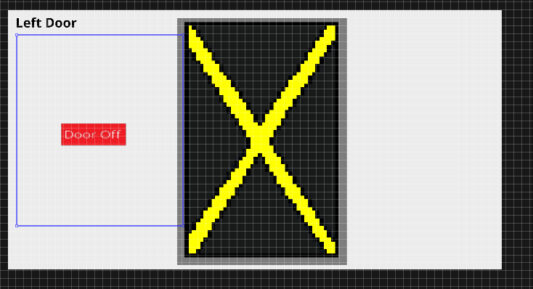
Game Build V.0.2
Date – 24/11/2025
What to do for Next Session
Work on sound designs for the game and the characters.
Use audio and SFX from other horror games as reference or for the smaller sounds.
Get Camera system operational
Summary Of Session
Refined Sprite designs such as the doors. Created template buttons for the doors both from main view and close-up view.
Named each zones area/location.
Created variables for obj_camera.
Added Up close door to the up close door zones for both left and right.

Slide 5
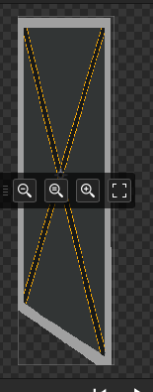
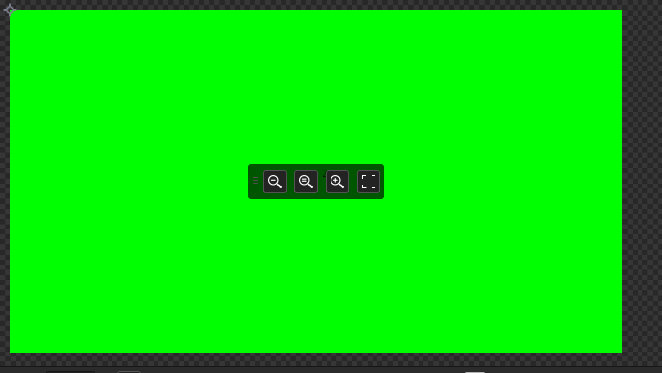



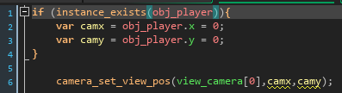
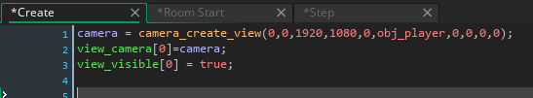
Game Build V.0.2
Date – 04/12/2025
What to do for next session
Get Cameras fully functioning.
Start gathering SFX for the game and soundtracks.
Research more into enemy AI.
Create draft for AMCD 00 Prototype design.
Create table for how the enemies will behave which room they’ll appear and how they interact with the player.
Key goal: Play/research games like Critical Failure to analyse how they function and how they were developed. Example games: Five Nights at Freddys, Sinking Iron, Slenderman, Baldi basics and many other indie horror games that follow Critical Failures Gameplay style.
Firstly, I have laid the foundation for the camera code and have it ready. However, I still need to make the camera alternate between camera zones based on a player clicking a button object.
Next, I changed the zones sizes to a respectful 1920x1080. This is due to the odd aspect ration of the game when it runs. This also helps make it more suitable for every display device. This change was also made to the camera’s width/height of the viewing area.
This has caused some issues with other sprites which were made too large or too small, however they are templates to help give a visual guide for the game’s development.
The doors width have been brought back from 220 to 200 to fit with the office pre-existing door frames.
Finally, I made the player object, but it will not have a sprite; it will function as a way for enemies to interact with the player and for the cameras to function.
I was unable to do sounds due to certain events that occurred between this session and the last one.

Slide 6
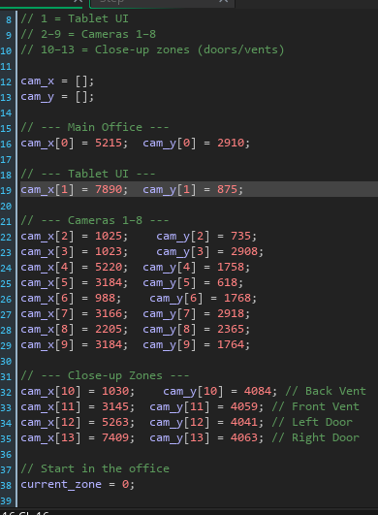
Game Build V.0.3
Date – 12/12/2025
What to Do next Session.
Create SFX and add Soundtrack.
Design the Prototype.
Finish Oxygen System.
Have Doors open and close.
Cameras are now fully function, with them correctly going to their respective zones as well as the camera Hud.
I have made up close vent/door buttons in addition to the vents actual sprite which is a landscaped version of the doors.

Slide 7
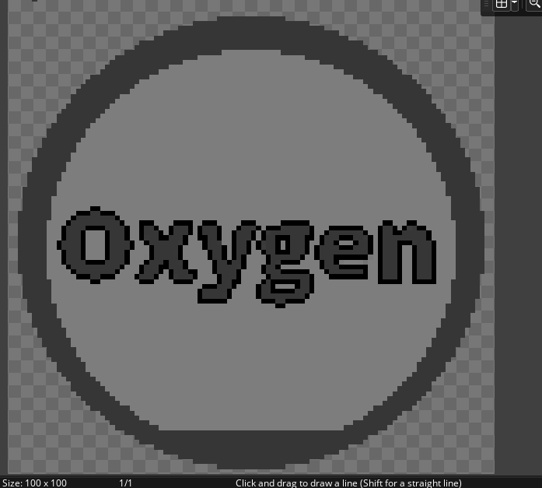

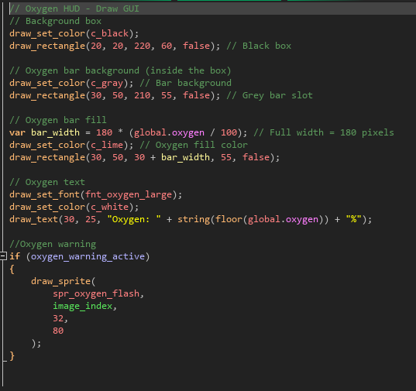
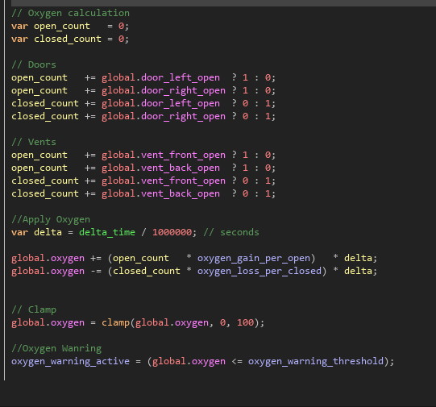
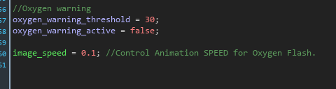
Game Build V.0.4
Date – 12/12/2025
What to Do next Session.
Plan Enemy Movement for all enemies.
Create 2 of the enemy AI’s
Finish Prototype design
Refine enemy sprite design
Adjust code for longer gameplay
In this session I completed in create the door/vent oxygen mechanic where when doors/vents are open oxygen increases and when doors/vents are closed oxygen decreases. In addition, the door mechanic was also completed and the doors/vents in both the up-close scenes and the main view open/close when the player presses the door/vent button. When ,ore doors/vents are closed the oxygens decent increases and the same works the other way around.
There is also a fill bar, displaying the oxygens percentage.
I also created a warning system for when oxygen is low and an animated sprite flashes red in GUI Draw.

Slide 8
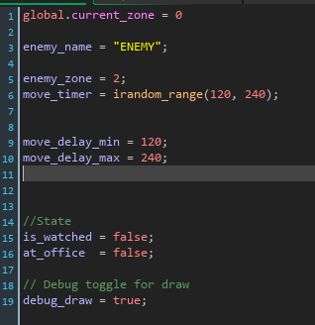
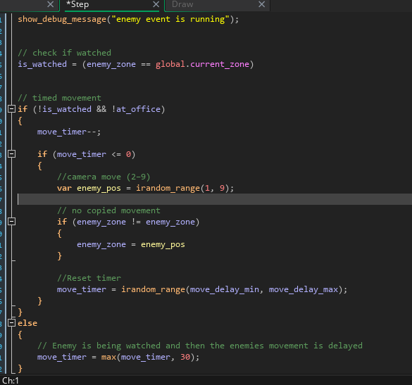
Unfortunately, due to mistakes and not having functional code Critical Failure V0.4.7.5 is officially a failed version of my game. To go into more detail, I was following an online guide for a specific piece of code, however I mistakenly forgot to save a version of the game with the original code, so when I altered it and made some deletions, I couldn't get my old code back. So, I decided to refresh and re-attempt it.
However, learning from mistakes form that version I made Critical Failure V.0.5. From here I re-designed the enemy movement code and was able to get a good start in creating the enemy's foundation.
I started by making an enemy parent which will give the enemies the information needed to know what zone they are in, where to move to and time taken to move. I also kept each enemy object in the game and within their code, they will be uniquely different from each other in terms of behaviour and movement.
Game Build V.0.4.7.5/V.0.5
Date – 08/01/2026
What to Do next Session. V.0.5.1
Due timing, enemy movement code is to be made in Critical Failure’s next version.
Make Each enemy Independent. A parent was used for their movement, but I want to have the enemies be independent of a parent. In the next version I will attempt to make the enemies not reliant on the controller for movement and only to communicate their location to the camera controller.
lay a foundation for the code for my enemies to act and move the way I want them to. As the game is, the enemies are moving but only through code not physically within the room. In addition, their movement isn’t organised and they cannot attack zone 0 the main office.

Slide 9
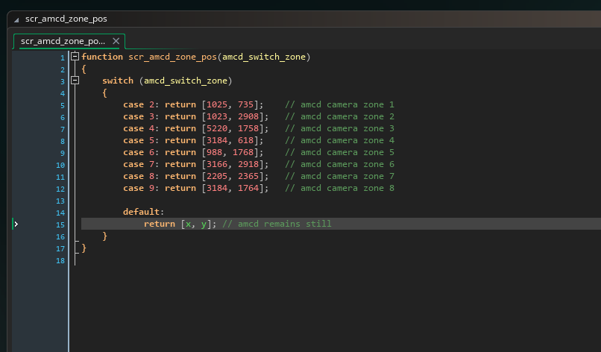
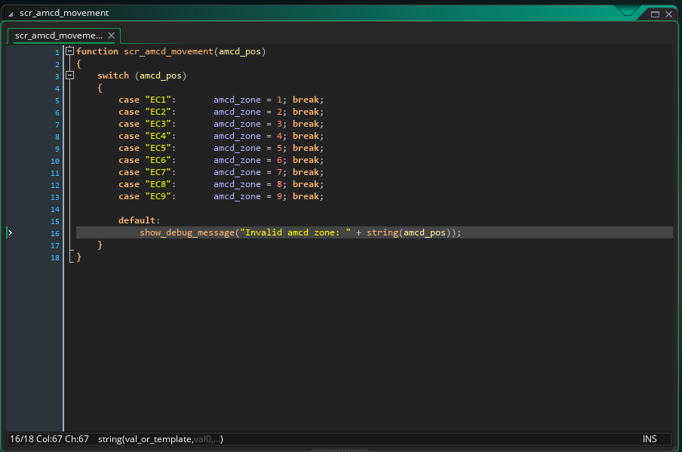
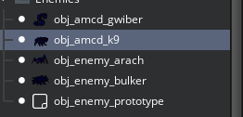

The enemies now successfully move independently, and the enemy parent is no more.
The reason for showing build V.0.5.2 is because for safety reasons build V.0.5.1 which as the current enemy parent will have the parent safely removed in build V.0.5.2 to ensure the enemies are 100% independent in both their movement and behaviour. It’s also to ensure that if removing the parent causes issues, I can fall back to build V.0.5.1 for a re-attempt. This is learning from build V.0.4.7.5.
I used the word ‘enemy’ as a placeholder for my code, but now to stick with the game, all code containing the word enemy will be replaced by ‘amcd’. This will not disrupt any code and will just be changing the variables names. This just makes it easier for me to remember the variables names.
I have also added office/zone 0 into the enemies’ movement.
The way the scripts work for enemies is like this. The script for enemy movement syncs with the camera controller into identifying where the enemy is and this will help with the is_watched section. Script amcd zone position is used to have the enemies physically move to different zones.
Game Build V.0.5.1, V0.5.2
Date – 10/01/2026
What to do next session
Have enemies only go to zone 0 if left_door_open or right door state = true.
Have enemies not attack before 5 seconds of being at an open door.

Slide 10
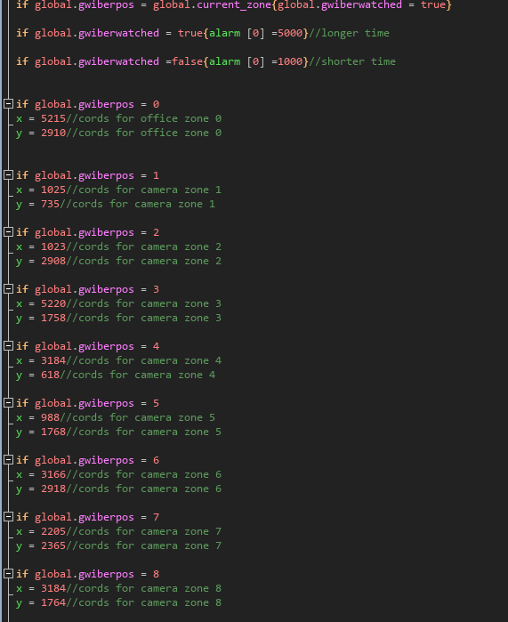
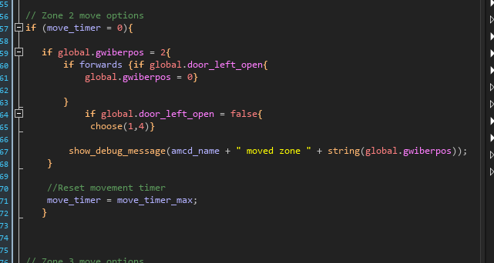
I have added alarms to Gwiber which trigger after how many frames have pasted, essentially the alarms are countdowns to execute their code, then in their code, Gwiber determines which zone it can move to and if it’s able to go to zone 0 the office.
The code that tells Gwiber what to do when in zone 2 in deciding if it can move to zone 0 only if left_door_open = true is the same format used for having Gwiber determine what zone its in and what zones to go to instead.
The code now makes it so that each zone Gwiber gives him options of which zone it can move to based on certain variables. More specifically zone 2 where Gwiber can only go to zone 0 IF the door is open.
Game Build V.0.5.4
Date – 11/01/2026
In addition, this specific code format not only makes each enemy independent but also make sit easier to code their behaviours.
For example, Arach, an enemy that doesn’t move like the others can just remain in zone 5 and only access zone 0 or change to zone 4 using the same line of code for what’s used in zone 2.
Also, this code can allow me to restrict their movement. Example, Gwiber can only move throughout the left side zones.
To do next session
Next session is to make current game into build V.0.5.5, this version is to be the most critical point where all the enemies code is set (doesn’t need tinkering yet) and from that point the game is in a stable runnable state.

Slide 11
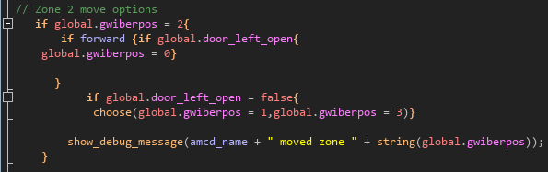
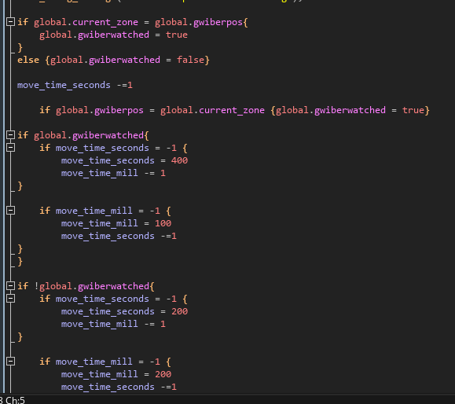
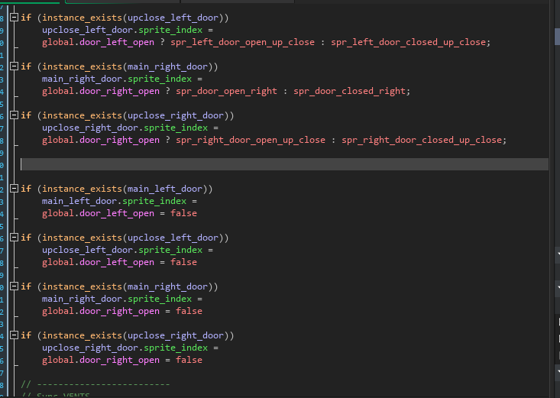
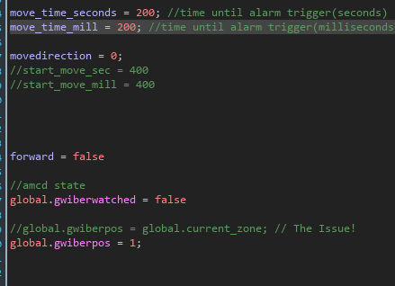
Gwiber officially moves and no longer requires an alarm. Gwiber reacts and calculates whether it is being watched and what zone it can move to. Gwiber also reacts to the doors state, knowing when the door is or is not open.
Gwiber’s movement is working as intended, delaying itself when watched, rolling its chance to move and to which zones are available to move to.
The key thing with this enemies, code is the lack of alarms. Instead of them I used Move timers. The move timers tell Gwiber the time until it should move. This also worked perfectly with the is_watched movement delay. This code though did come with some issues such has door sprites disappearing despite normal behaviour and Gwibers very low chance of going into zone 1.
The best part is that Gwiber has basically 1% relation to global.current_zone which was theorised to be the cause of previous problems.
Game Build V.0.5.5
Date – 14/01/2026
To do next session
Refine Gwiber’s code. Gwiber might be moving but he doesn’t have much in terms of behaviour such as delayed movement in zone 0 before jump scare, sounds and speed.
To do next session 2
Create SFX for objects
Begin writing Script for Game Start
Death Screen
Make more zones if possible.

Slide 12

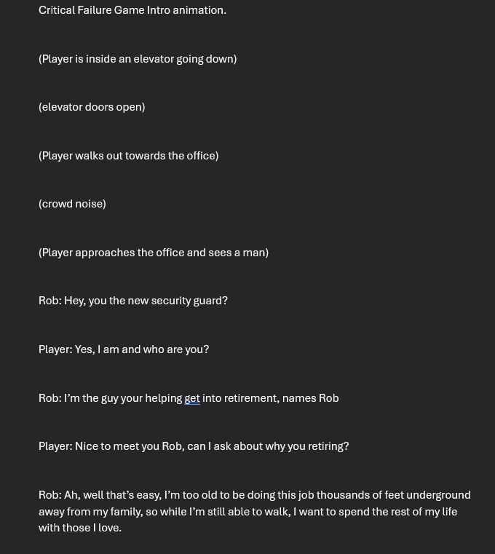
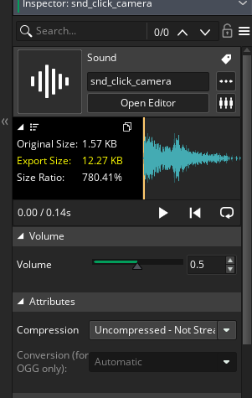

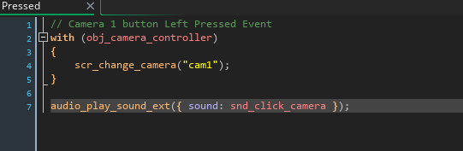
In this session I begun creating voice-lines for my newly made characters for the first part of the game, the introduction.
I’ve also researched throughout the internet for smaller SFX such as Camera Opening, clicking and basic door sounds. I’ve already added a clicking sound to my Camera buttons.
The new characters are Rob and ESA.
Rob is the now retired security guard who helps settle you into your job role.
ESA is an unlikely Ai companion after the devastating Critical Failure affecting the entire facility. ESA stands for Evacuation Safety Assistant.
I have also written a word document, a script for the first part of the game, the intro. This is to help future plan animations and storytelling.
Game Build V.0.6
Date – 16/01/2026
To do next session
Refine Gwiber’s code. Gwiber might be moving but he doesn’t have much in terms of behaviour such as delayed movement in zone 0 before jump scare, sounds and speed.

Slide 13
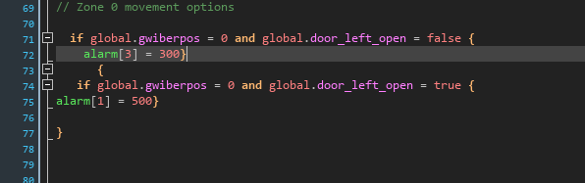

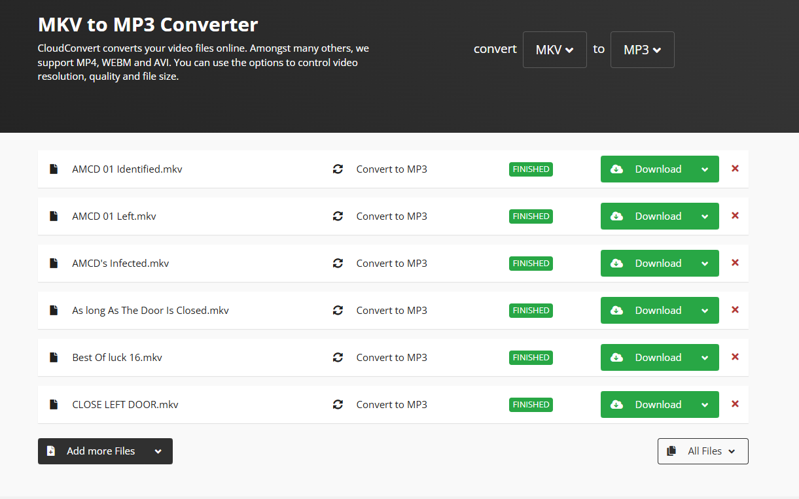

This Build Is the finished refined code for Enemy Gwiber.
Mainly what he does while inside of zone 0, the main office.
This was done by using timed alarms for when Gwiber is in zone 0. Alarm one only triggers when Gwiberpos = 0 and door_left_open = true same goes for alarm 3 but with the door = false. Alarm 1 triggers after 500 frames and then jump-scares the player. Alarm 3 triggers after 300 frames to then have Gwiber change to zone 2.
I also finished all of ESA’s voice lines and all of Rob’s Voice Lines using a Text to Speech AI software. I also had to convert them to MP3 to work in Gamemaker.
Game Build V.0.6.1
Date – 17/01/2026
To do next session
Create sounds for objects.
Begin storyboarding intro sequence.
Start Designing Zones.
Finish Adding ESA voice-lines to Game-Maker.
Alarm 3

Slide 14
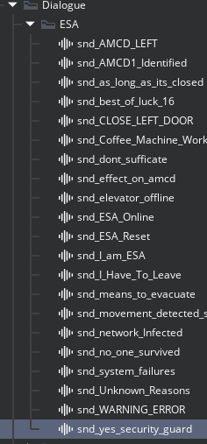
I have finished converting 85% of ESA’s Voice-Lines and put them inside of the Sounds folder.
The Attempted zone 0 code for Gwiber from the previous build has caused some issues for the rest of Gwibers Movement code and at the time of typing, actively searching for the reason behind the problems. (Visit Build Test 7 in alpha testing table for more details)
To help resolve this issue I have made a folder containing Build V.0.6 (Functioning Enemy Movement) then in the same folder added the latest version Build V.0.6.3 Which has the attempted updated code to try and give Gwiber movement behaviour in zone 0+jump-scare, however, this came with some issues.
Game Build V.0.6.2
Date – 20/01/2026
To do next session
Resolve Gwiber’s movement Code
Design Jump-Scares for AMCD’s
Start adding minor mechanics such as end game, game menu, pause menu and control scheme.
Finish AMCD’s Designs.

Slide 15
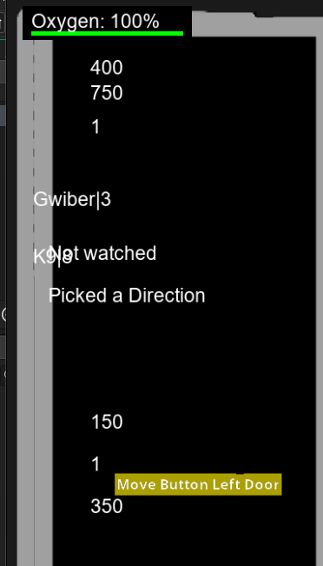
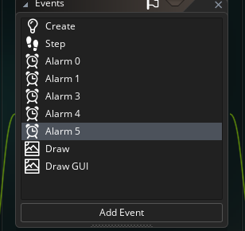
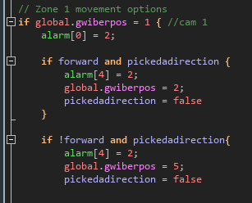

I was able to fix Gwibers Movement code and now his movement is more concrete.
The issue before was that my original code was made on light scaffolding, so when I tried adding zone 0, the whole movement code broke.
Having some assistance from a friend, we were able to discover the flaws and now Gwiber moves correctly and his behaviour is working 100%. We did remove gwiberpos zone 0 from his code due to the realisation that it wasn’t needed for his movement.
The jump-scare is also working, however for some reason the instance_create isn’t creating the jump_scare object for Gwiber.
Also, with Gwiber finished, I moved onto K9 in which I altered the original camera layout to have K9 attack both the left and right doors. He, is also extremely quick but the enemy's speeds will be adjusted once all of them are completed.
Lastly, instead of the watched code making the enemies movement timers longer, it instead makes the movement countdown slower when watched and faster when not watched, since the original code caused some problems with other timers.
Also, most of the code in the step event has instead been moved into alarms, for all of Gwiber’s code was running off one frame, which caused a lot of issues.
Game Build V.0.6.3
Date – 21/01/2026
What to do Next Session
Complete the rest of the enemie’s code.
Start making new levels
Finish making the death-screen room and menu options.
Shrink current zones to 400x200 due to size issues and memory. Then adjust code in Camera controller, Gwiber and K9 to new co-ordinates. This will open the opportunity to add more zones.
K9 follows the same code format as Gwiber just with the addition of the right zones and door.

Slide 16
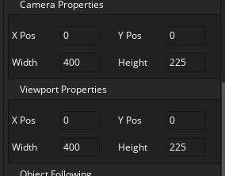

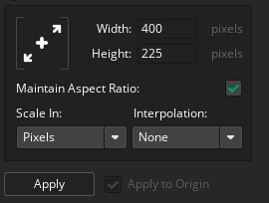
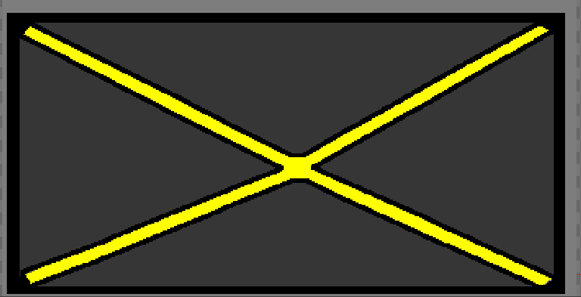

I decreased the size of the current zones and then made the correct adjustments to the Camera and Enemies co-ordinates for where the zones are.
I finished designing the buttons for the menu screen room and finished creating the death-screen room.
The new starting room is now the menu screen room with buttons allowing the player to start game. I Have also made a 3rd room for displaying the control schemes as an optional button for the player to use while in menu screen room.
The Main zones such as the office were tricky to re-size so I did some maths and for the doors/vents to match the size of the new zones 400x225, I will divide their current size by 4.8 which was the divided decrease the camera zones shrunk by. 1920 divided by 400 = 4.8. So, the doors are 1000x1000, so I divide 1000 by 4.8 to get a more accurate measurement. 1000/4.8 is 208.3 to the nearest 10. So, to make it easier I’ll just shrink it to 208. For the main view doors, they are 200x740, however, I don’t need to divide their numbers for I can just use my eyes to size them to the new scales.
Game Build V.0.6.4
Date – 22/01/2026
What to do Next Session
Make Zones Smaller without breaking the viewports.
Safely Remove Smooth Movement.
Make Death-Screen
After shrinking everything down and correcting the Co-ordinates of the Camera Positions, I attempted to make the game go full screen while not affecting the viewports size. However, I figured Out that I haven’t defined the size of each camerapos since the old code worked fine when everything was 1920x1080 but this time the zones are 400x225 and the viewport is offset.
I have also removed smooth transitions and discovered that my camera code was reliant on smooth transition to create variables for the rest of the camera’s code to use. So, removing it caused the cameras to stop working. Visit test 9 for more details.
The Vents currently are 2000x1050. So, 2000/4.8 and 1050/4.8. 2000/4.8 = 416.7 to the nearest 10 so I’ll round it up to 417. 1050/4,8 = 218.75, so It will be rounded to 219.
New vents sizes. Width 417, Height 219. Unfortunately, for no reason, I cannot resize the current vents correctly, so I will re-do them in their new sizes.
The enemies have also been scaled down from 1040x1040 to 200x200. Besides Arach because he has a unique size, so for Arach its 200x133.

Slide 17
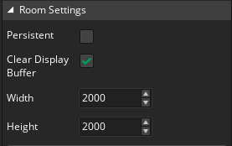
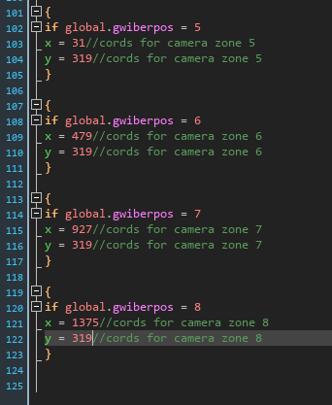
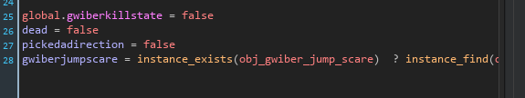
In this build I went back to Build V.0.6.4 Failed and made it build V.0.6.4.5
This time instead of shrinking and resolving the viewports in the current room, I will make a new room in a more appropriate size for more optimization.
The new co-ordinates for the zones are…
Zone 0 – (30,576)
Zone 1 – (479,575)
Zone 2 – (31,31)
Zone 3 – (479,31)
Zone 4 – (927,31)
Zone 5 – (1375,31)
Zone 6 – (31,319)
Zone 7 – (479, 319)
Zone 8 – (927,319)
Zone 9 – (1375,319)
Zone 10 – (31,831)
Zone 11 – (479,831)
Zone 12 – (927,575)
Zone 13 – (1375,575)
I have also re-added the code that allowed Gwibers Object to originally move parallel to his movement code. So, then the object appears.
Of course, with the new positions of the zones.
This code is also put inside of K9 with the correct variables.
Re-adding this code back has offered me the opportunity to have the enemies Jump-scares trigger when they are physically in zone 0 for the current trigger code doesn’t seem to work in the movement code for the enemies..
I’m using the door state code for changing sprites based off certain conditions which will help greatly in having the enemies jump-scares appear.
Game Build V.0.6.4.5
Date – 23/01/2026
What to do Next Session
Make Death Screen
Create Menu Buttons and Death Screen buttons.
Begin making Level 2
Create Jump-Scares for rest of the enemies.
I had to make Gwibers Killstate a global to have the jump-scare have a condition for when it should change Gwibers Sprite.
I also, re-attempted to re-do my camera code for I no longer wish to have smooth transition and I believe to have found a method that doesn’t require viewports. To ensure that I don’t lose the old code for safety reasons I will make Build V.0.6.5. This new code was tested in test 11 build V.0.6.5.

Slide 18

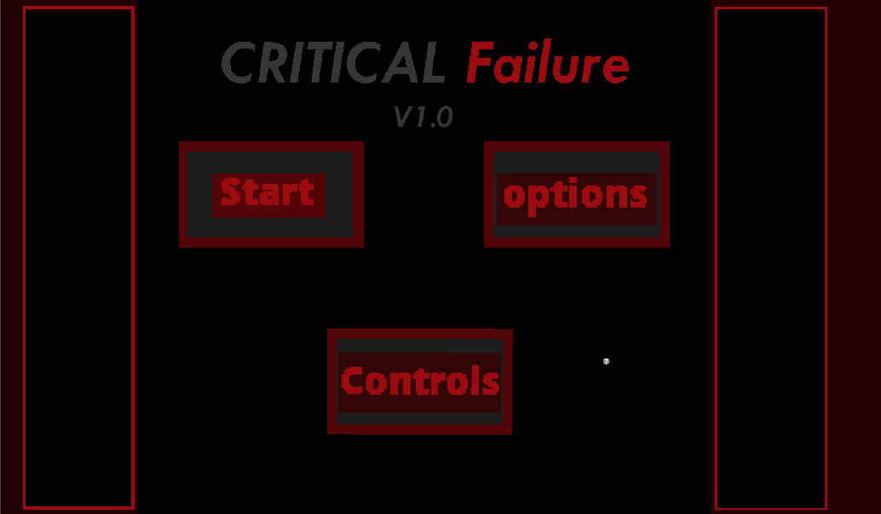
Build V.0.6.5 has working enemies (Gwiber and K9) and the new camera controller is 100% completed.
Rm_office is now Level 1. (rm_level1)
I have also finished designing the buttons and background for the menu and death screens. The start button takes the player to level one with Gwiber and K9.
Game Build V.0.6.5
Date – 23/01/2026
What to Do next session
Create Level 2
Finish Death Screen
Code Bulker and the other enemies for level 2.

Slide 19



Bulker’s code is a copy of Gwibers just with re-named variables and timing.
I have begun making Level 2 for my game, expanding off the current zones. Level 2 will introduce Bulker into the roster of enemies.
In total there are 20 zones for level 2. I do need to note that every time I add a new zone, I need to update the script and the value that the buttons represent. 14/20 of these zones are camera zones for both the player and the enemies.
Also, the new updated camera hud layout is much bigger meaning I will have to try and work around the camera view, at least for zone 1 (Camera Hud).
Also, added some Place-holder sound effects to use for key parts of the games like enemy movement and doors closing.
Also, for some reason, when game starts somehow level 2 is affecting level 1 so all I get is a dark screen when I click start.
Game Build V.0.6.5
Date – 26/01/2026

Slide 20


This an continuation of the previous slide. I have discovered the problem, and it was my lack of care. I was making edits to the same camera controller level 1 was using.
I’ve made two controllers now both for their respective rooms and I’ve restored the original Camera Controller.
Turns out I need duplicate versions of everything that uses the change_camera_script to have the camera work for each new room.
Game Build V.0.6.5
Date – 26/01/2026
What to Do next session
Finish Enemies code based on new zones.
Start on Level 3
Code Arach
Make player go to death screen when killed.
Make about button

Slide 21




I have changed the options button to be an about me page which basically just me talking about why the game was made.
I also made ait so that when the player dies either from an enemy or due to low oxygen, they get teleported to the death screen room.
Made Multiple new rooms, including a level selector for the player to choose what level they wish to begin in.
For the enemies, they will have duplicate versions of themselves per level. Mainly due to the problem of them containing future zone code in the first level but breaking if they tried access a non-existent zone.
Altering their code is very simple, for all I need to do is just add the extra zones to their pre-existing movement.
Game Build V.0.6.5
Date – 27/01/2026

Slide 22





Extension of previous slide. I want to mention how Bulker remain at the door longer than the other enemies do.
its simply this code
In alarm 6.
When the office right door is closed his movement time increases from 1500 to 2000. (Adjustments may be made in the future)
Now all the enemies in my game at least for level 2 move correctly and have the correct behaviour.
To solve the size difference for camera Hud zone I just changed the set size view for when you both exit and open the camera.
Next with the death screen finished, coded for the player to change room to rm_death_screen when oxygen = 0 or when enemy jump-scares. To do this I gave each enemy a deathscreentimer. This timer is to give time for the jump-scare to finish before the player moves to the death screen room.
For oxygen, I added a somewhat new mechanic, I had this mechanic originally but removed it for I didn’t see a need for it is the health bar. When oxygen = 0 the health bar goes down by 0.5 and cannot be restored.
Game Build V.0.6.5
Date – 27/01/2026

Slide 23


Continuation.
This is just to mention the player health mechanic.
When oxygen = 0, player health goes down by 0.5. When player health = 0, go to death screen room. Then the timer resets itself back to 100.
I also copied over the GUI code for the oxygen to get a status bar that decreases and increases. However, the player Health cannot be restored if oxygen is restored.
Game Build V.0.6.5
Date – 27/01/2026
What to Do next session
Code Arach
Create Level 3
Create more zones

Slide 24



Arach’s code allows him to move between zones 5 and 8. During this, if the front vent is open while he’s in camera 5, he will proceed to go on the offensive but just a second after the attack timer begins Arach plays a vent sound so the player can have time to react fast enough to close the vent. This plays the same for when he is in camera 8.
I can now move onto my next build V.0.7.1 where I’ll begin designing the prototype and begin transferring the level 3 objects into level 4 which is easier for, I do not plan to add more zones at this time.
Also, making Level 4 was a breeze since I didn’t need any more new zones meaning I could just copy level 3 without needing to change much besides variable names.
If you are looking through my versions, you might have noticed that I recently started using lvl instead of level. This was done just to safe time and make naming much easier to do. So, lvl is just Level.
To make Prototype I will use level 3 K9 as the foundation for the prototypes code.
Finally Prototypes design is completed.
I always planned for him to me a fusion
Of the other AMCD’s and I think it came
Out perfectly.
Game Build V.0.7/.1
Date – 29/01/2026

Slide 25
Continuation.
The Prototype or AMCD 00 will just like its design take attributes from the other AMCD’s into itself.
Prototype will have…
K9 speed
Bulker waiting Time
Gwiber’s low sound movement.
Arach Audio
For coding the Prototypes code will be setup similarly to K9 with adjustments made of all the AMCD’s behaviours into Prototype.
there will also be 2 special features for the prototype to increase its difficulty.
Random movement times. This will make Prototype unpredictable and require you to be constantly active on the camera’s or else he’ll reach your office while your distracted by Arach.
Fake sounds. The Prototype will sometimes make fake sounds, tricking the player into thinking he’s moved or is about to attack.
Game Build V.0.7.1
Date – 29/01/2026
What to Do next session
Design Zones
Find suitable Place Holder sounds
Make level 5 with all the AMCD’s.
Adjust enemies code for more balanced gameplay.
Display level timer.
Re-do Health Bar.
Finally, in the main menu add the Soundtrack I created for Critical Failure.

Slide 26
This part is the next big step In completing all the code for my game and refining it to full functionality.
This session, I implemented Bulkers long waiting time at door to the Prototype.
The Game will Run at 60fps. Doing this allows me to get the correct amount of time in seconds or minutes in game by using the equation (frames = minutes x 60 x room_speed). This will allow me to properly adjust the timers used by objects in each level.
I have also implemented a Pause screen during the levels, just in case the player wishes to go back to main menu or take a break.
Narratively, the game would take the main character 12 hours to survive until 12pm. However, that time doesn’t translate well in terms of gameplay. So, the level will be 7 minutes and 30 seconds long and the level timer will change its sprite based off what stage the timer is at. So, using the equation frames for 7min and 30sec minutes of gameplay per level is 27,000 frames.
I’ve also added new rooms for the levels for when the player completes a night that has a transition into the next room.
I did run into an issue and that was having the Enemies physically move alongside their movement code. They do, but they are so offset you can’t see them. Despite me using the same exact co-ordinates as the camera controller, it turns out the enemies don’t follow the top left co-ordinate like the camera. So, I’ve spent over an hour getting the right co-ordinates and adjusting the enemy’s sprite origin to centre middle.
This has proven to be very time consuming for I need to constantly start up the game check An AMCD’s physically position and adjust their code, rinse and repeat for all variants of the enemies in all the levels. I was only able to do lvl1 Gwiber and K9 and lvl2 Bulker, the other level 2’s have been difficult.
Game Build V.0.7.2
Date – 30/01/2026
What to Do next session
Fix offset enemies.

Slide 27
I have made the soundtrack for the intro part of my game. When the player clicks the button to go to the next level, the sound stops.
I’m gonna use the Windows XP error sfx for when Prototype makes a fake noise. I also want to add lots of small rare easter eggs in my game, just to bring some more life into the game. These are extremely rare and probably won’t happen on most peoples first playthrough.
Game Build V.0.8
Date – 31/01/2026
What to Do next session
Fix offset enemies.
Design Zones.

Slide 28


I have designed all the zones and have also found a solution to the offset issue.
I plan to make the zones sprites change when the enemies enter them. This means I won’t need my enemies to have sprites and provides me full customisability within each zone.
The way it works is that I have my current zones with no enemies, I will duplicate these and add the AMCD’s into them separate. So, Gwiber Zones, Bulker Zones and K9 Zones etc.
To have the zones change sprite I will create a Zone Controller that basically acts as a way for the Zones to know when to change sprites based off certain conditions. (This will also be good for sounds).
Game Build V.0.8.1
Date – 1/02/2026
What to Do next session
Make Zone Controller
Make Level lock (stop the player from going to level 2 unless level 1 is beaten.
Make AMCD versions of zone sprites.

Slide 29


All zones are fully designed and have duplicate variants for each AMCD.
The way this works is that the camera zones change their sprites based off whether an enemy is inside of them or not.
Here’s a flow chart of what I want the mechanic to do.
Gwiber moves to Cam 1
Gwiberpos = 1
If gwiberpos = 1 (inside zone object)
Change obj_cam_zone_1 sprite to spr_zone_1_gwiber
If !gwiberpos = 1
Change obj_cam_zone_1 sprite to spr_zone_1
That’s the flow of how this mechanic will work.
Game Build V.0.8.2
Date – 2/02/2026
What to Do next session
Draw enemies inside the same zone as their position to show they are in it.
Fix Cam 7 on Level 3.
Finish adding place-holder sounds.
Adjust Enemy movement timers
Adjust level timer
Adjust oxygen depletion
This is all the code needed per position. This is done for all AMCD’s. The code is done inside of the object zones.

Slide 30

In this session I adjusted the enemies and all of the timers to giver critical failure more appropriate gameplay. I also fixed the Cam 7 problem and adjusted the oxygen depletion.
I also, added some more sounds into the game such as for cameras and enemy movement.
I also Started Drawing in the enemy versions of my now designed zones. In addition, I’ve made a new category of zones in which if 2 or more enemies are in the same zone then they’ll both appear.
I also made a small fix and that was to remove the oxygen flash sprite after death for it continued to persist throughout all rooms.
Game Build V.0.8.2
Date – 3/02/2026
What to Do next session
Continue with enemy sprite zones.
Adjust timers
Refine mechanics
Add remaining sounds.

Slide 31


I’ve made big changes and I apologies to moderators about not mentioning them separately since this happened across multiple days.
So, what did I do.
I finished searching for sounds and began implementing them into my Game. There is also directional audio for the left and right sides of the map.
Enemies now trigger left/right versions of footstep sounds that play whether an enemy is in Camera zone 2 or 7.
I have finished designing the enemy versions (Besides Arach for he doesn’t need one) of the Camera zone and the mechanic of the zones changing based on the enenmypos. However, my original code didn’t reset the sprites after the enemy leaves it, so I have had to experiment with different methods, one of these methods is having the enemies when they change zone and are in a particular zone, reset the previous one instead of automatically doing it as soon as it leaves it.
I finished Implementing all the code for the zone change.
I properly adjusted the enemies and room timers to be more appropriate.
I have also doubled the oxygens decreasing rate for I found that the player could survive the night by having all the doors closed.
I also added a debug tool that allows me infinite oxygen for me to check that the enemies are moving correctly and the zones change appropriately. O-on F-off. NOTE: This is for development purposes and will not be a feature.
Date – 5/02/2026
Game Build V.0.9
What to Do next session
Make zone change sprite controller.
Design Double Zones for enemies.

Slide 32

I apologies for this gap in my development log and me not mentioning the two previous versions before V.0.9.3.
To catch things up V.0.9.1 to V.0.9.2 were my attempts in making the zone sprite change controller. Unfortunately, I failed in both versions to create a working version of the zone sprite change mechanic.
I started by giving each individual zone object code telling them to change their sprites based on if an enemy or enemies are in it. The zones changed sprites but didn’t return to normal and was separate from the enemies' movement.
In, V.0.9.2 I tried adding the zone sprite change into the enemy's movement code using object_set_sprite(). This also didn’t work same as V.0.9.1. The issue seemed to lie with the fact that the zones couldn’t revert to their original sprite.
V.0.9.3 is where I have a working change zone mechanic. A Friend of mine gave me guidance and explained to me that instead of using object_set_sprite, I instead make the alternate zone sprite versions into objects and use instance_layer to create the object zones and destroy them.
The way it works is quite simple. What the instance_layer does is guarantee that the zone object is removed and then replaced. This code was used inside of Level 1 Gwibers movement code. The code checks if Gwibers next zone, the one he’s moving to is or isn’t occupied by K9. This allows Gwiber to destroy the next zones instance layer and replace it with the correct one based on if K9 is or isn’t in it. This also works the other way around and if Gwiber moves to lets say 1 from 2, Giwber will check if K9 is or isn’t in Zone 2 and Replace Zones 2 object accordingly.
Note: Only Level 1 and Level 1 Gwiber have this code.
I also designed the Double Zones for when enemies are in the same zone together.
Date – 9/02/2026
What to Do next session
Finish level 1 enemies zone change mechanic
Design jump-scares
Implement Jump-scares into the game.
Game Build V.0.9.3
Last thing, I made a sound controller to make it easier to manage the sounds in the game.

Slide 33
In this session I implemented to Jump-scares to work similarly to how the enemies change zone.
How the jump-scares work is that when dead = true the death screen timer begins, counting down to when the player should change to the death screen room. During this time, the jump-scare happens. What the Jump-scare is, is just the enemies forcing the players camera view to go to the jump-scare zone in which the enemies can then change it into their jump-scare. Scaring the Player :).
This was done using a newly added zone that only the enemies can interact with. This will be the jump-scare zone. The enemies can change this zone as they please into the version related to the enemy that killed you.
I have run into a problem concerning the aftermath of player death. The door and vent controller is persistent meaning that even after dying the doors/vents that are closed, remain that way after death. The issue with the doors/vents is that their code isn’t as simple as making global.door_open = true. The doors and vents are synced with each other and require themselves to change sprite as well as know what state they are in for the oxygen count. I’m going to try and find a solution to this.
Zone change code didn’t work in the sense that the enemies did change the camera zones sprite but didn’t revert it back to normal.
Date – 10/02/2026
What to Do next session
Make Doors and Vents be in an open state after death.
Find a solution to the zone change
Game Build V.0.9.3

Slide 34

I have found a solution to the zone change and made sure to test it constantly to ensure full functionality.
The Camera zones now do change based on whether an enemy is or isn’t in the zone.
This was done by changing and destroying the zones instances every time the enemy is about move.
Instead of changing the sprite I decided to change the object instead. This did come with some challenges, mainly because this code is extremely fragile. If I were to name 1 variable wrong, the entire code collapses. To ensure full functionality, I made sure to focus primarily on Level 1 Gwiber before adding the code to level 1 K9 and so on so forth.
I’ve added the zone change code into K9 by copying Gwibers version. However, I needed to be careful about using the correct naming.
Level 1 is now fully playable, and I also made it so that you automatically move onto the next night after finishing the current one.
Level 2 is also complete.
Also, vent/door open state after death was a very easy fix and it was just the fact that my controller was persistent and only existed in 1 room. After, turning persistent off and placing 1 in each level the vents/doors return to normal since room restarts itself after the player leaves it.
I want to mention the steps for the zone change. Step 1, the enemy checks what zone they are leaving, then step to they check what zone they are moving to. This is the core of the code and one I must follow if I wish to have my enemies change zones correctly.
I also gave the enemies a room start event that changes their zone as soon as the room begins, this just makes them visible before they move.
Date – 12/02/2026
What to Do next session
Game Build V.0.10 and V.0.10.1
Also want to mention that the rest of the place-holder sounds have been added, but some do not have code to trigger them yet, I will do this once V.1.0 is made to ensure everything is completed, also the rest of the double zones have been designed except for the triple zones.

Slide 35
In response to feedback and the addition of my original idea, I will be adding an animatic to my game narratively explaining the core functionality of my game while explaining why the player is in a facility.
This was coded similarly to how the camera controller and buttons work. This camera controller though for this room will be less complex and will have very basic functions such as the camera buttons to get the player used to the gameplay.
The camera view will change based off which animatic zone the player is looking at.
Sound will also be added, but I will have to use timers to prevent the player from skipping too far ahead and allow the sounds to play properly in addition to the animatics themselves.
There will be some assets being re-used such as the office and enemy sprites due to some parts of the narrative needing coverage of it.
Essentially, I’m making a very slimed down version of level 1 with only a small amount of camera zones.
I plan to do an animatic for only level 1 for now since that’s all I’ve written in the story script, but if I have more time, I will do it for the other levels such as the additions of new enemies.
There will also be some zone change code, particularly for the scenes that are brand new and for showing how the enemies move.
Date – 10/03/2026
Game Build V.1.0

Slide 36
Test Number | Room | Objects Involved | Expected Outcome | Actual Outcome | Test Outcome
Numerical Value of test beginning with 1. | What Room your test will be conducted in. | The Objects that your test will utilise during the test. | What is expected to happen during the test. | What Actually happened. | Did you have to do anything In reaction to the test? Fixing errors or changing code.
1 – Build V.0.3 | rm_office/rm_start_up_screen_init | obj_camera, scr_change_camera, obj_office, obj_cam_zone 1-8, Close Up scene zones. | When the game runs, the camera goes to the office zone from there the player can click on the doors to move to the close-up door zones. In addition, when Pressing Key C, they change camera view to the Camera Hud Zone where they can interact with the obj_cam_1-8 to change cameras. They can press C again to return to camera Hud or press V to return to office. | When the game starts I am taken to the office zone and are able to interact with the buttons and they all go to their respective zones and all keys function properly. | During practise with this code I did have to correct the co-ordinates due to them not being accurate, in addition I had issues due to my background being off which caused Duplicates of the zones to appear. Both were fixed by changing the Co-ordinates and turning on background.
2 – Build V.0.4 | rm_office | Door and vent objects open/closed, obj_oxygen_door_controller | When doors/vents are open oxygen increases, when doors/vents are closed oxygen decreases. When door/button is pressed the doors/vents of both main view and up-close will open and close according to the players selection. In addition, if multiple doors/vents are open or closed the oxygen rate increases or decreases. The text displaying oxygen will change its percentage based on oxygen amount. | The game starts with all doors closed so oxygen is 0%. When two doors are opened nothing happens, but when the back vent opens the oxygen rapidly increases but reaches 100% despite one vent still being closed. The doors/vents buttons work and the vents/doors open and close correctly. The code works, just have an issue with the front vent not being open at start. | I changed the controllers code to have all the doors and vents set to open upon starting the game. This allows for the game to start with 100% oxygen. I have solved the issue with oxygen rate increasing and decreasing incorrectly. So, now if more than 1 door or vent is open, based on the amount open/closed the oxygens rate will Increase/decrease. Only issue is that the front vent for some reason starts with the closed variant of its sprite but that can be easily solved next session.

Slide 37

Test Number | Room | Objects Involved | Expected Outcome | Actual Outcome | Test Outcome
Numerical Value of test beginning with 1. | What Room your test will be conducted in. | The Objects that your test will utilise during the test. | What is expected to happen during the test. | What Actually happened. | Did you have to do anything In reaction to the test? Fixing errors or changing code.
3. Build V.0.5.4 (Note: there was a test for build V.0.4.5 however I accidently overwritten this PowerPoint causing me to lose it. However, that test was for the amcd’s movement which worked and this test is for the new updated enemy movement. | Rm_office | Obj_amcd_gwiber | Gwiber is to change zones based on what zone its currently in and whether or not it is currently able to go to zone 0 from zone 2. Gwiber should also have its movement delayed when global.gwiberpos = global.current_zone. | Gwiber moved from zone 1 to zone 5 but remained their, it didn’t move back to zone 1 for it to move to zone 2 ect. Due to this I couldn’t confirm if the watched mechanic was working or not. | At the time of this test, I have not made any changes besides trying to give Gwiber a draw GUI to see if he is in fact moving or not. Update: got a GUI draw and I can confirm that Gwiber doesn’t move from zone 1. Also, using debug show I can confirm that Gwiber is running its step event but alarm 0 is not, meaning that the step event is having problems triggering alarm [0].
4. Build V.0.5.5 | Rm_office | Obj_gwiber, obj_oxygen_door_controller | Gwiber has a move timer that when it reaches 0, will reset to 600. when it goes 0 Gwiber does a zone check and determines based on a 50/50 chance which zone it can move two. Specifically for zone 2, Gwiber must understand if the door is In an open or closed state before moving into zone 0 (The Office). | Gwiber does move between zones based on the timers. However, Gwiber moves from zone 1 straight to zone 0 when it should only be able to go to zone 2 or 5. Also, for some reason the code that tells Gwiber if the doors are open or closed had caused the door sprites to disappear in addition to teleporting the other enemy objects when button is pressed. Gwiber does not go into zone 0 when left_door_state is closed. | This code causes the doors sprites disappearing But it is also needed to give Gwiber information in whether the door is in an open state. (Ok don’t know why or how but the doors are fixed?)

Slide 38
Test Number | Room | Objects Involved | Expected Outcome | Actual Outcome | Test Outcome
Numerical Value of test beginning with 1. | What Room your test will be conducted in. | The Objects that your test will utilise during the test. | What is expected to happen during the test. | What Actually happened. | Did you have to do anything In reaction to the test? Fixing errors or changing code.
5. Build V.0.6 | rm_office | Obj_cam_1 | When player clicks on obj_cam_1 sound snd_click_camera plays. | The sound does not player when player clicks on obj_click_camera. | To fix I made some adjustments and chose a different sound code and now it works, the sound code that works is audio_play_sound_ext({ sound: snd_click_camera }); which replaced, audio_play_sound(snd_click_camera, 1, 1, 1, 7336,10,100).
6. Build V.0.6.1 | Rm_office | Obj_gwiber, object doors | When Gwiber is in zone zero wait for a certain amount of time before triggering a jumpscare, if door is closed while Gwiber is in zone 0 before the wait timer runs out, retreat back to zone 2. | When Gwiber moves from zone 4, to zone 3, then to zone 2, when he enters zone 0 the wait timer doesn’t trigger and jump scare sprite doesn’t trigger before room restart. | Solution was to create a alarm timers and have Gwibers movement from Zone 0 not be related to his forward and !forward code. So, now he is working as intended, jump-scaring only when the door is open and if he’s in zone zero, if he’s in zone 0 and door is closed then alarm 3 will trigger for 500 frames then have him move back to zone 2. If door is open trigger alarm 1 after 500 frames, then jump-scare unless door is closed during that time.

Slide 39
Test Number | Room | Objects Involved | Expected Outcome | Actual Outcome | Test Outcome
Numerical Value of test beginning with 1. | What Room your test will be conducted in. | The Objects that your test will utilise during the test. | What is expected to happen during the test. | What Actually happened. | Did you have to do anything In reaction to the test? Fixing errors or changing code.
7. Build V.0.6.2 | Rm_office | Obj_enemy_gwiber | When Gwiber enters zone 0, if the left door state is open, he triggers alarm 1 which has a count down of 500 frames then jump-scare sound plays and a jump-scare sprite appears (No death Screens Made Yet). If door is not in an open state trigger alarm 3 which runs for 300 frames before executing its code for Gwiber to move back to zone 2. | At start of Game Gwiber immediately moves to zone 3 from 4 and all timers are frozen. This is not meant to happen, and it appears that the new zone 0 code may have disrupted the rest of Gwibers movement code. | Fixes will be made in the next session for Build V.0.6.3
8. Build V.0.6.3 The Updated repaired code for enemy movement. | Rm_office | Obj_gwiber and K9 | When game starts Gwiber starts in zone 4 and makes his way to the office. If the office doors are closed Gwiber can’t enter zone 0. If Gwiber is in zone 0 but the door is now closed, he will retreat to zone 2. K9 starts in zone 5 where he decides whether to go left to CAM1 or right to CAM8. K9 only goes forwards, but when he’s at zone 2 (left door) or zone 7 (right door) if the doors are closed, he’ll go back to zone 5 then he will repeat this cycle. | Gwiber does exactly what he’s supposed to do and so does K9. There are still no end game screen at this point so soon after jump-scaring from either K9 or Gwiber their movement freezes and they remain stationary. | I have added a death-screen room and started creating the buttons for the menu and death-screen. The Jump-scare not appearing was fixed

Slide 40
Test Number | Room | Objects Involved | Expected Outcome | Actual Outcome | Test Outcome
Numerical Value of test beginning with 1. | What Room your test will be conducted in. | The Objects that your test will utilise during the test. | What is expected to happen during the test. | What Actually happened. | Did you have to do anything In reaction to the test? Fixing errors or changing code.
9. Build V.0.6.4 | Rm_office | Obj_camera_controller and obj_game_state. | When game starts, the game should be set to full screen and with the zones still being 400x225. Also, the smooth transition code has been removed due to that feature not being needed for the cameras. | The game doesn’t start in full screen correctly and the screen is blurry. The removal of the smooth code caused the rest of the camera’s code to break. This is because when I first made the code, I considered transitions and made a place-holder one, but accidently made the place-holder also the essential part in creating variables for the camera code | I couldn’t fix the camera problem so, everything will return back to its normal size for now.
10. Build V.0.6.4.5 | (new) rm_office | All Objects | Game now in a room size of 2000x2000 and all objects correctly sized, the game should boot quicker than before and the camera code with the new positions of the zones should function normally. I adjusted the speed of smooth amount to be faster due to the fact that it was a placeholder and I have no need for it but removing it breaks the camera so the plan is just to make it so fast that it’s not noticeable. Gwiber and K9 are the only enemies in the level for this is level 1. | The Game runs normally, however, the screen is not full, so I need to enable the game to be full screen. All objects works just like they normally would and in addition, the game starts faster than before making my game more optimized now.

Slide 41
Test Number | Room | Objects Involved | Expected Outcome | Actual Outcome | Test Outcome
Numerical Value of test beginning with 1. | What Room your test will be conducted in. | The Objects that your test will utilise during the test. | What is expected to happen during the test. | What Actually happened. | Did you have to do anything In reaction to the test? Fixing errors or changing code.
11. Build V.0.6.5 | Rm_office | Obj_camera_controller | When the game starts, the view should only be for the main office at the correct size. | The view was set, however the view is stretched vertically and no matter that the dimensions are it continues to stretch.
12. Build V.0.6.5 | Rm_level1 | Obj_camera_controller and door controller | When I close either the left or right door a sound will play signifying the fact the door has been closed. | Game breaks when trying to move to an up-close zone but this can just be a simple cause of when I tried altering the camera controllers code incorrectly. | Fixed it, it was just because I altered the wrongly, now its fixed and I’m making duplicate Versions Of the Objects to have work in Level 2.
13. Build V.0.6.5 | Rm_level2 | Obj_amcd_bulker_lvl2 Obj_amcd_gwiber_lvl2 Obj_amcd_gwiber_lvl2 | Gwiber and K9 retain their original movement but now have access to extra zones. Both Gwiber and K9 should know what to do when they are in zones 14,13,12 and original lot. Bulker now fully coded and should move correctly and stop moving when watched. | Gwiber and K9 move like normal. Bulker also moves and he does stop moving when watched, however he is a little fast so adjustments will need to be made.
14. Build V.0.6.5 | Rm_level2 | Obj_camera_controller_lvl2 Obj_exit_camera_lvl2 Obj_open_camera_lvl2 | When the player opens the Camera, the view size changes to the same size as the Camera Hud zone and when the player exits the Camera, the zone returns to its original size. | It did exactly what I wanted it to do and there are zero bugs from it. This means I can expand my camera Hud zone even more to have additional zones.

Slide 42
Test Number | Room | Objects Involved | Expected Outcome | Actual Outcome | Test Outcome
Numerical Value of test beginning with 1. | What Room your test will be conducted in. | The Objects that your test will utilise during the test. | What is expected to happen during the test. | What Actually happened. | Did you have to do anything In reaction to the test? Fixing errors or changing code.
15. Build V.0.6.5 | Rm_level2, rm_death_screen and rm_level1 | Object enemies | When dead = true, deathscreentimer decreases by -1 and when it reaches 0, moves the player to the death screen room. | When dead = true, timer goes down and when it hits zero player is taken to rm_death_screen, however, for some reason some assets are appearing in the death room which is not meant to happen. Besides that the code is working. | The issue was that they were all persistent. So, to prevent this form happening again, I will disable the persistent objects for they have no connection to any other room.
16. Build V.0.6.5 | Rm_level1 and 2. | Obj_oxygen_door_controller | When oxygen 0, playerhealth decreases by 0.5. When health = 0, go to death screen room. | When the oxygen = 0, health goes down and when health = 0, death screen appears. However, the timer continues afterwards which I do not want. It might be because I have the code in the step event which is set to persistent = true. | I’m going to try and make the healthbar a separate object instead of having be persistent in door controller. Also, in addition to this to fix the health bar not resetting, I made it so that if the value of playerhealthbar is ever less than 0, reset back to 100.
17. Build V.0.7 | Rm_level3 | Obj_amcd_arach | When Arach is on zone 5 and the front vent is open, Arach will start his attack timer and just a second after play the vent crawling sound. When the attack timer = 0 and the front vent is still open. He jump-scares the player. If the door is closed, he will retreat back to zone 5 or 8. | Arach moved instantly from 5 to 8 but remains there and his attacktimer doesn’t reset. This is most likely due to my poor effort of converting K9’s code for Arach. I will re-attempt Arach by duplicating K9 and just having it be Arach and limited to 2 zones. | The fix was easily made. All I did was duplicate K9’s code and re-named the variables to Arach and only gave him two zones to move between. He now functions perfectly, makes a sound when he’s about to attack and he moves between zone 5 and 8.
18. Build V.0.7.1 | All levels | Object buttons | When mouse hovers over movement buttons and open/close camera buttons, the buttons events trigger. | Yes, the buttons do trigger when mouse enters the objects area. | I have decided not to go forward with this idea but I’ll leave this here as evidence of experimentation.

Slide 43
Test Number | Room | Objects Involved | Expected Outcome | Actual Outcome | Test Outcome
Numerical Value of test beginning with 1. | What Room your test will be conducted in. | The Objects that your test will utilise during the test. | What is expected to happen during the test. | What Actually happened. | Did you have to do anything In reaction to the test? Fixing errors or changing code.
19 – Build V.1.0 | All rooms | Obj_sound_controller_lvl1 - 5 | The sound controller loads in audio groups and is used to make the sounds for when enemies are in cam 2 or 7. It also plays sounds for enemy movement such as K9’s, for every time he moves. Lastly it plays a remix of my critical failure soundtrack in the background acting as ambience. | Left hallway sound plays when enemy is in cam 2. Right hallway sound plays when enemy is in cam 7. Ambience didn’t play or sometimes overwrote the rest of the game sounds such as the doors. Lastly, K9’s footstep sound does play every time he moves. | I managed to fix the ambience, and it was just the fact that it was in the incorrect audio group, but moving it to the default one worked, stopping it from overwriting the other sounds.

